Slide 1
Clique Cover Problem
Reduction and Hardness proof
Group No: 10
Student ID:
1505002
1505044
1505057
1505097
1505101

Slide 2
Clique Cover Problem
Input: An undirected graph G(V,E) and an integer K.
Output: True if the vertices of G can be partitioned into K sets S_{i} ,whenever two vertices in the same sets S_{i} are adjacent. S_{i} do not need to be disjoint, they can be non disjoint. But we can make them disjoint by putting common vertices in only one set without any problem. Thus we can think S_{i} are disjoint.
Note: There is also edge clique cover problem but we are only interested in vertex clique cover. So if we say clique cover, we are indicating vertex clique cover.

Slide 3
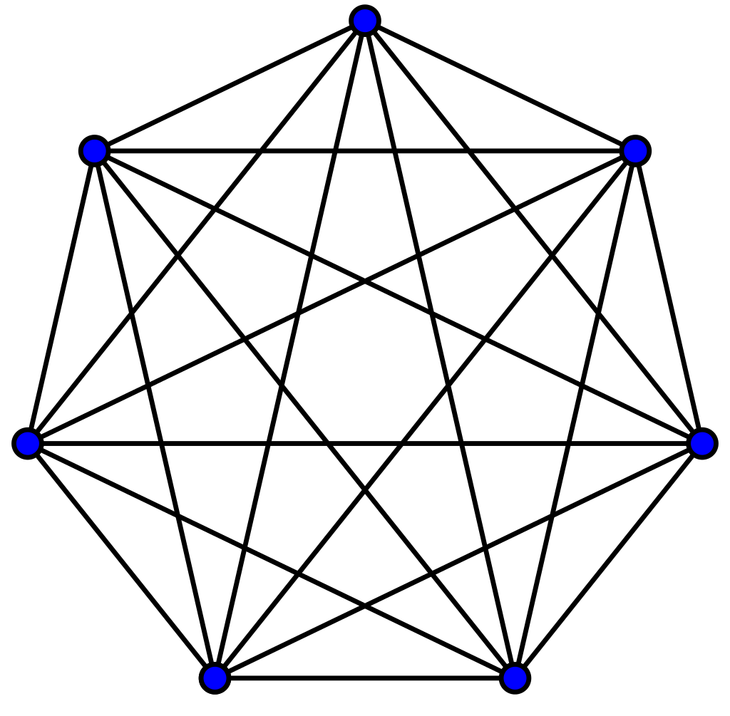
Complete Graph
A complete graph is a simple undirected graph in which every pair of distinct vertices is connected by a unique edge.
Fig : Complete Graph(k₇)

Slide 4
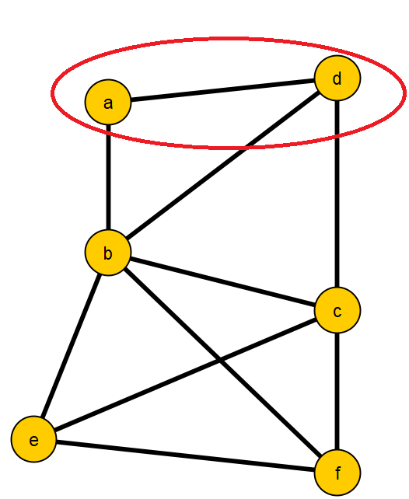
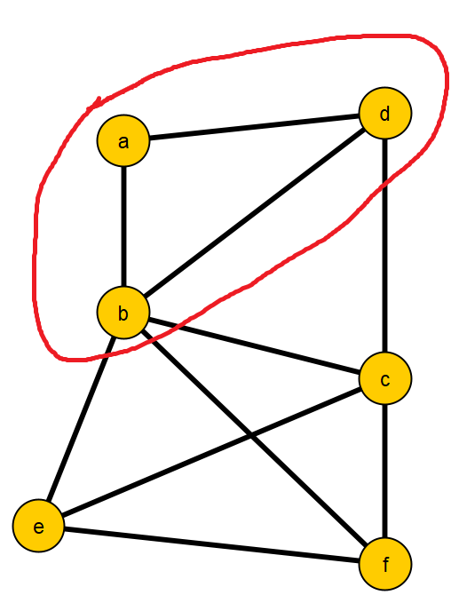
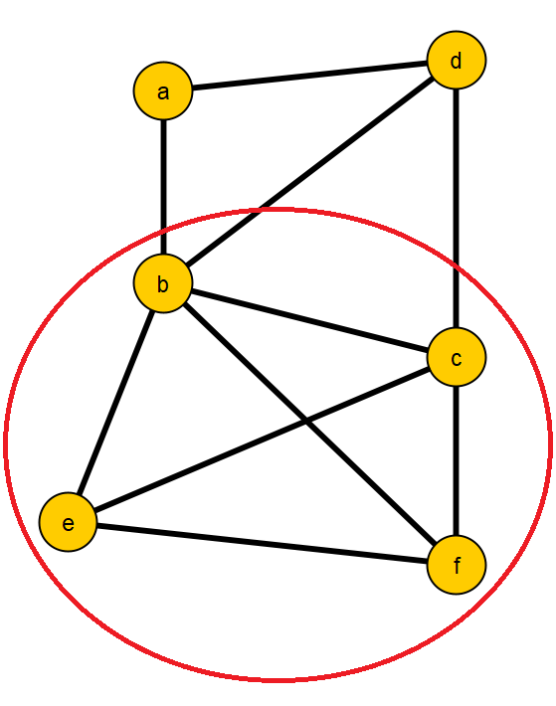
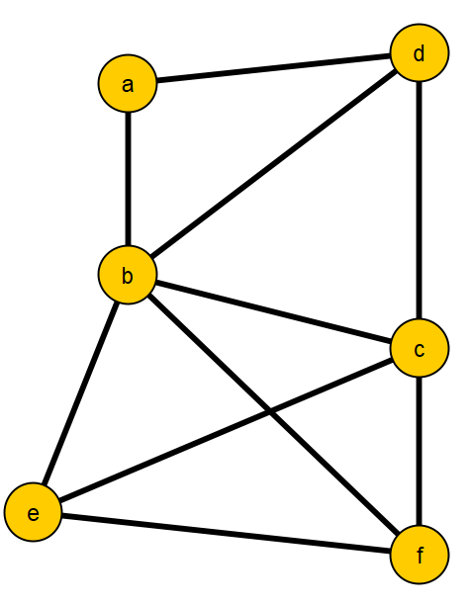
Clique
A clique of a graph G(V,E) is a complete subgraph of G.

Slide 5
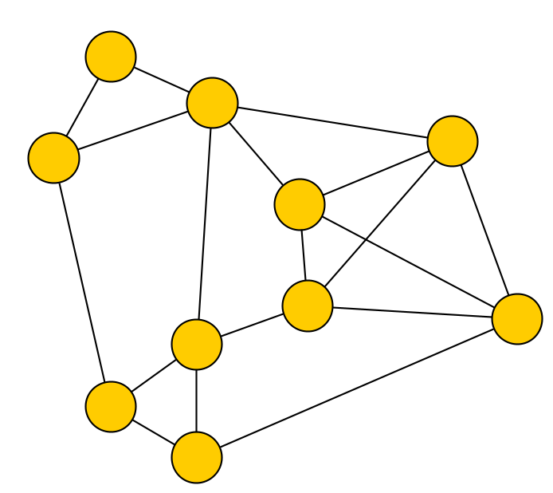
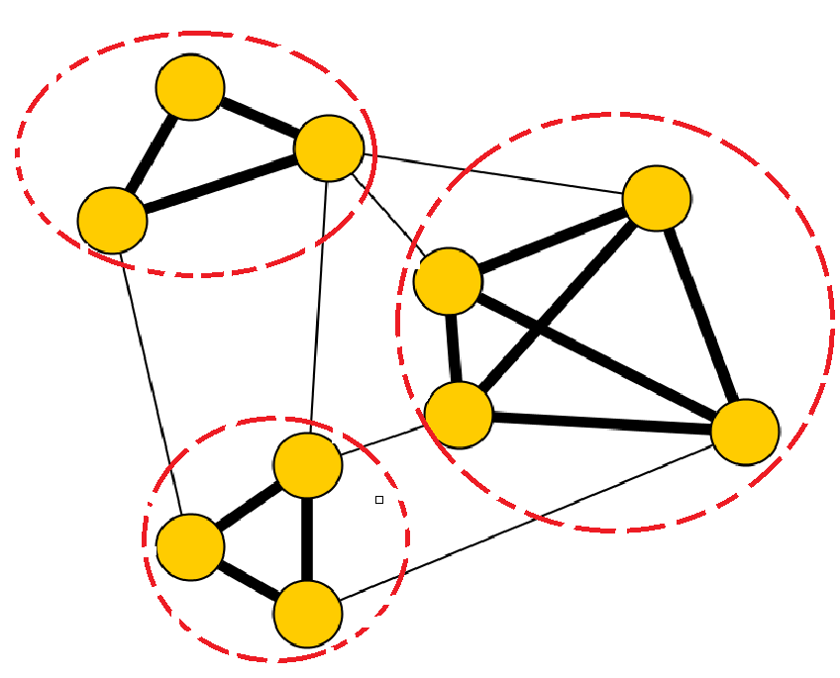
Clique Cover Problem
True because the vertices of G can be partitioned into 3 sets S_{i} ,where two vertices in the same sets S_{i} are adjacent.
Given a graph G(V,E) and integer k = 3.

Slide 6
Why do we need to study “Clique Cover Problem”

Slide 7
Let’s look at a scenario...
C
D
A
B
F
E
G
I
H

Slide 8
Let’s look at a scenario...
C
D
A
B
F
E
G
I
H

Slide 9
Let’s look at a scenario...
C
D
A
B
F
E
G
I
H

Slide 10
Let’s look at a scenario...
C
D
A
B
F
E
G
I
H

Slide 11
Let’s look at a scenario...
C
D
A
B
F
E
G
I
This problem can be solved using “Clique Cover “ algorithm.
H

Slide 12
Other Applications
DNA molecular solution problem, data partitioning problem in embedded processor-based systems (memory chips), image processing problems etc.
Applications of the vertex clique cover problem arise in network security, scheduling and VLSI design.
Algorithms for clique cover can also be used to solve the closely related problem of finding a maximum clique, which has a range of applications in biology, such as identifying related protein sequences.

Slide 13
Reduction from Clique Cover

Slide 14
Hardness Status of Clique Cover Problem
The clique cover problem in computational complexity theory is the algorithmic problem of finding a minimum clique cover, or (rephrased as a decision problem) finding a clique cover whose number of cliques is below a given threshold. Finding a minimum clique cover is NP-hard, and its decision version is NP-complete. It was one of Richard Karp's original 21 problems shown NP-complete in his 1972 paper "Reducibility Among Combinatorial Problems".
The equivalence between clique covers and coloring is a reduction that can be used to prove the NP-completeness of the clique cover problem from the known NP-completeness of graph coloring.

Slide 15
Proof of NP-completeness
To prove that clique cover is NP-complete, first we prove that it is in NP.
We are given a graph G(V,E) and the clique cover of the graph of size k that is k subsets of V. We first check whether each such subset form a complete graph that is any two vertices of a set are neighbors. If not the answer is no. Otherwise we again check if union of all the sets is equal to V. If not the answer is no otherwise yes.
Clearly, this takes at most (O(n^2)) where n is the number of vertices . So, the clique cover problem is clearly in NP.

Slide 16
Proof of NP-completeness
The next thing we do is show that it is NP-hard.
To do so, we show that the clique cover set problem is at least as hard as the k-coloring problem.
Claim
K-coloring ⩽_{p} Clique Cover

Slide 17
Reduction from K-coloring
If a graph is k-colorable, then it can be partitioned into k independent sets (one for each color class).
Then we just exploit the normal reduction between Independent Set and Clique Cover by taking the complement graph (we swap edges for non-edges and vice versa), so any independent set becomes a clique.
Claim
K-coloring ⩽_{p} K-Independent Set
K-Independent Set ⩽_{p} Clique Cover

Slide 18
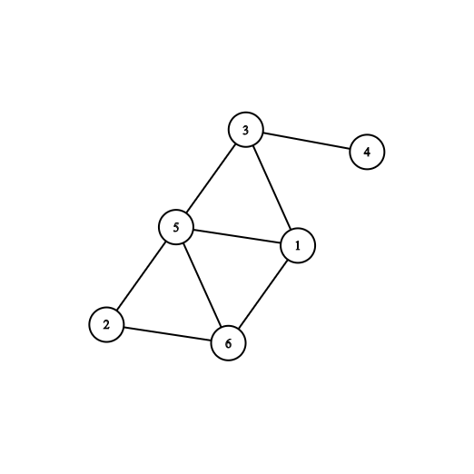
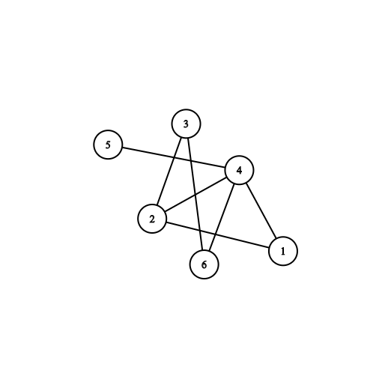
An Example...
Figure: G
Figure: G

Slide 19
Reduction from K-coloring
So if G(V,E) is k-colourable, it can be partitioned into k independent sets.
Hence G(V,E) (complement of G(V,E)) can be partitioned into (i.e. covered by) k cliques.
Conversely if G(V,E) can be covered by k cliques, G(V,E) has a partition into k independent sets, and hence is k-colourable.

Slide 20
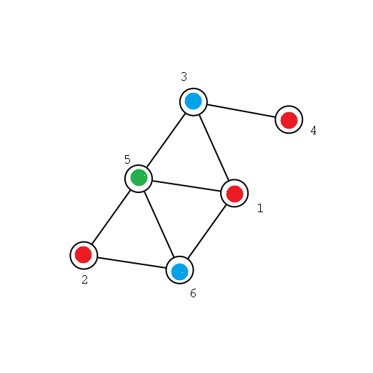
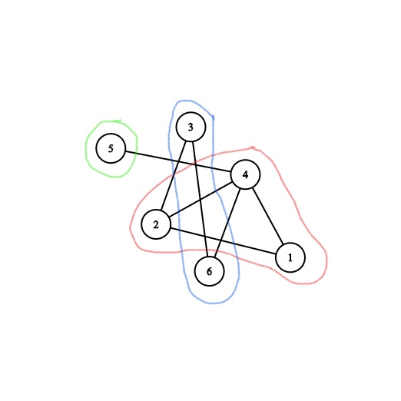
An Example...
Figure: G
Figure: G

Slide 21
Clique Cover is NP-complete!
Theorem
The Clique Cover problem is NP-complete.

Slide 22
Transitivity of Reducibility
If A is reducible to B and B is reducible to C, then A is reducible to C.
E.g. Independent Set ⩽_{p} Vertex Cover and Vertex Cover ⩽_{p} Hamiltonian Cycle, then Independent Set ⩽_{p} Hamiltonian Cycle .

Slide 23
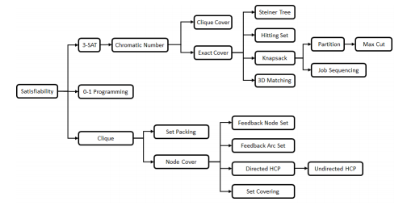
Fig : A tree showing the 21 NP-complete problems identified by Karp, where the edges correspond to individual reductions.

Slide 24
According to the “Transitivity of Reducibility” theorem , 3-SAT ⩽_{p} Chromatic Problem ⩽_{p} Clique Cover Problem.
Unfortunately, we could not find any problem that Clique Cover Problem reduces to.
But there is a related NP-complete problem named Clique Edge Cover problem . It concerns partitioning the edges of a graph, rather than the vertices, into subgraphs induced by cliques.

Slide 25
Clique Cover and It’s Variation
Clique Cover Decision Problem:
Given a graph G(V, E) and a number K, we need to answer yes or no if we can partition V(G) in K cliques
Minimum Clique Cover Problem:
Given a graph G(V, E), we need to output the smallest number for which clique cover exists. This number is called the clique cover number.
Both of these problem are equivalent. That means if we solve one of the problems we can easily construct a solution for the other problem in polynomial time from that solution.

Slide 26
Solving minimum clique cover solves the clique decision problem
Suppose, clique cover number is X, then for each integer between X and |V| (inclusive of both), answer for clique decision is yes. Otherwise answer is no.
It is obvious that answer for K = X answer is yes.
Now we can extract a vertex from a clique of size p ( p > 1) and make two cliques of size 1 and p-1 respectively. Thus making the answer for K = X + 1 yes.
We can continue in this way making K = X+2 answer yes and so on till K = |V|. When K = |V| we are left with all one length clique so no further reduction is possible.

Slide 27
Solving clique decision problem solves minimum clique cover
Suppose, we can solve the clique decision problem with program P.
Now iterate through K = 1 to |V| and ask P for each K if answer is yes or no. While iterating, the first number for which answer is yes, is the clique cover number. Thus solving the minimum clique cover problem. The complexity is O(|V|)*complexity of clique decision problem.
Alternatively we can Binary Search in range [1, |V|] to find the first integer which is yes. We can do this because the sequence is like this: No, No …….. No, Yes, ……… Yes. This gives us significantly lower complexity than first approach. The complexity is O(log|V|)*complexity of clique decision problem.

Slide 28
Special Classes of Graph for Which Clique Decision or Minimum Clique Cover is Solvable in Polynomial Time
This class includes Path Graph, Cycle Graph, Complete Graph, Triangle Free Graph. Details are discussed in next slide.

Slide 29
When K = |V|
In this case answer for clique decision problem is always yes for any graph.
How? We can just make each vertex a clique.

Slide 30
Complete Graph K_{n}
For complete graph, clique cover number is 1
It is obvious from first point, for clique decision problem for all K = 1 to |V| answer is yes.

Slide 31
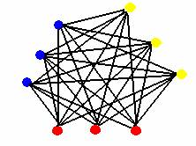
Complete K partite graph K _{n1, n2 … np}
Clique cover number is max( n₁, n₂ ….. n_{p} )
We can easily take one vertex from each partition to make a clique. If there is no vertex left in a partition to take, no need to take any vertex from there. Thus creating a clique cover of size max( n₁, n₂ ….. n_{p} ). Answer is no less than this because we can not put two vertex from same partition in same clique. Thus giving clique cover number max( n₁, n₂ ….. n_{p} ).

Slide 32
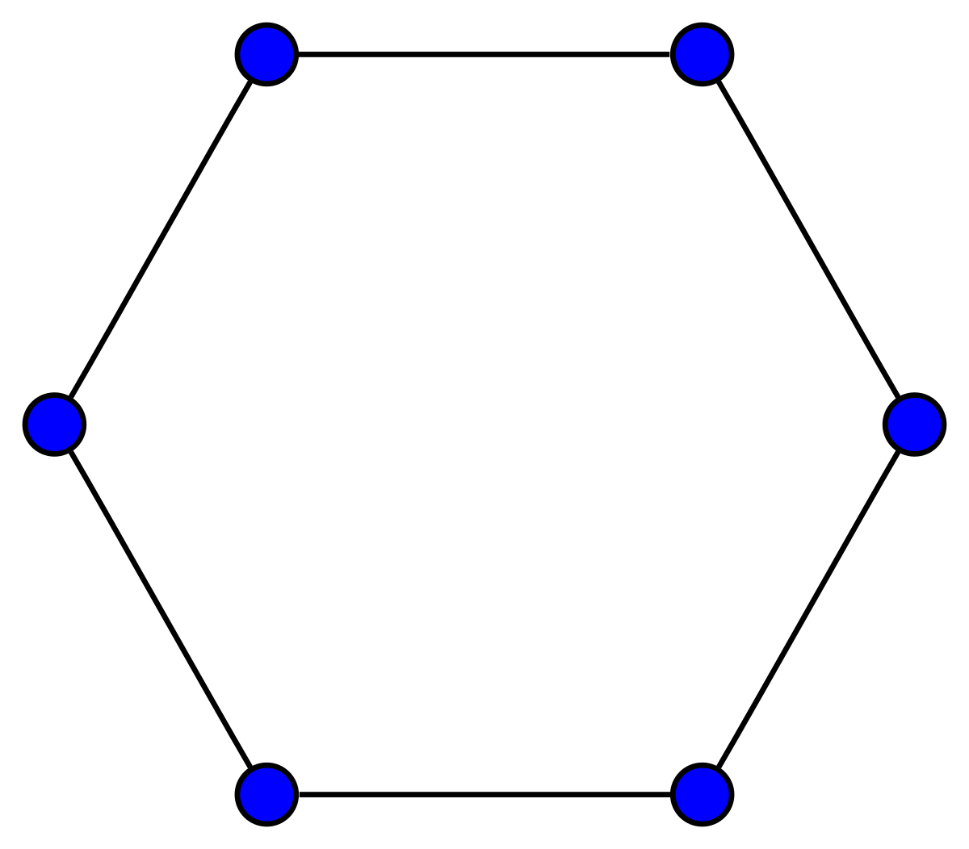
Cycle graph C_{n} or Path Graph P_{n}
For a cycle/path graph clique cover number is n/2 if n is even, (n+1)/2 if n is odd.
It is obvious that no clique can have more than 2 vertex in a cycle/path graph. Thus we can take maximum two sequential vertex in a clique. So the clique cover number can not be greater than ceil(n)/2.
Now we have clique cover number n/2 if n is even. For n is odd we have a clique of size 1 thus giving a clique cover number (n+1)/2 if n is odd.

Slide 33
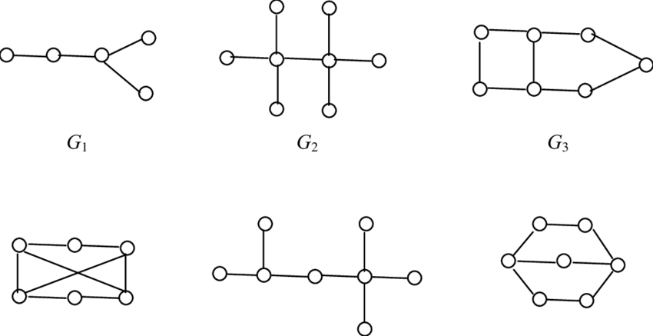
Triangle Free Graph
It is obvious that in triangle free graph maximum clique size is two. So we make as much as two size clique possible. How we do that? Maximum matching.
For vertices not in maximum matching we make each of them one sized clique
Thus we have a clique cover number = |V| - maximum matching
Note that Triangle Free graph is the general case of cycle and path graph.

